Slide 1
Student Economic Forum 2024

Slide 2
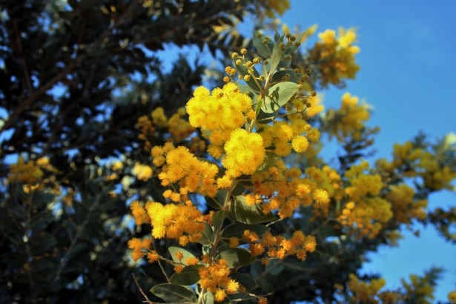
Kaya
Kaya. I acknowledge that ETAWA in partnership with Curtin University delivers services on the country of many traditional custodians and language groups throughout Western Australia. I acknowledge and respect the Wadjak Noongar people, the traditional custodians of the boodja (land) on which I am presenting on today. I recognise their continuing connection to the boodja, bilya (rivers), ngamma (waterholes) and karda (hills) and I pay my respects to their Elders past and present.

Slide 3
Welcome and Introductions Nick Ognenis

Slide 4
Agenda
Welcome and Introductions
Curtin University Welcome
The Economic landscape
The Exam – What I Need to Know
Morning Tea
Economic Scenarios
Student Activity/Presentations
Closing remarks
Nick Ognenis (ETAWA)
Madi Stirling (Curtin University)
Sam Collins (CCIWA)
Steven Kemp
30 minutes
Nick Ognenis (ETAWA)

Slide 5
The Economic Landscape Sam Collins

Slide 6
The Exam – What I Need to Know Steven Kemp

Slide 7
Morning Tea 10:30am – 11:00am

Slide 8
Economic Scenarios A-G Student Presentations

Slide 9
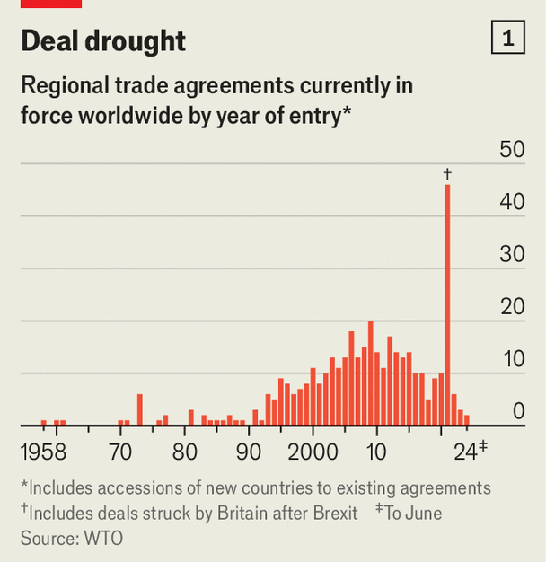
Student Presentations – Topic A Australia’s International Trade & Free Trade and Protection
Examine the graph above and answer the following questions:
Using examples, describe two differences between bilateral and multilateral agreements.
Outline the importance of trade agreements for the Australian economy.
Outline why many countries pursue protectionist international trade policies instead of trade agreements and describe how protectionist policies impact trade and market efficiency.
Source: The Economist, (2024)

Slide 10
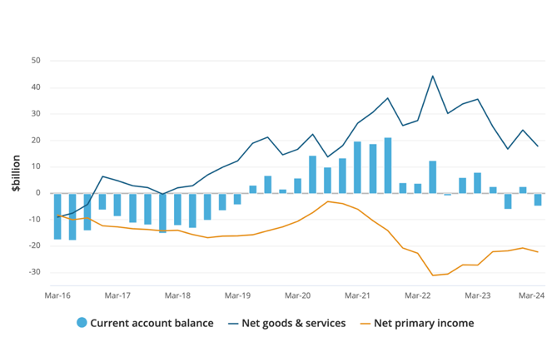
Student Presentations – Topic B Balance of Payments & Foreign Investment
Current account balance (a), main aggregates
Examine the graph and answer the following questions:
Identify four reasons for Australia’s current account surplus in the last five years.
Explain the relationship between Australia’s income balance and the level of Australia’s net foreign liabilities.
Outline the benefits of foreign investment for the Australian economy.
Source: ABS (March 2024)

Slide 11
Student Presentations – Topic C Exchange Rates
Examine the graph and answer the following questions:
Distinguish between the concepts of an exchange rate and the trade weighted index.
Discuss whether an economy is better off with a low exchange rate or a high exchange rate.
Explain how a depreciation of the Australian dollar is likely to impact different components of the Balance of Payments.
Source: Reserve Bank of Australia (2024)

Slide 12
Student Presentations – Topic D Monetary Policy
Examine the graph and answer the following questions:
Identify the current cash rate and state the RBA’s current monetary policy stance.
Explain the impact of this monetary policy stance on the Australian economy.
Explain one strength and one weakness of monetary policy compared to fiscal policy.
Source: Reserve Bank of Australia (2024)

Slide 13
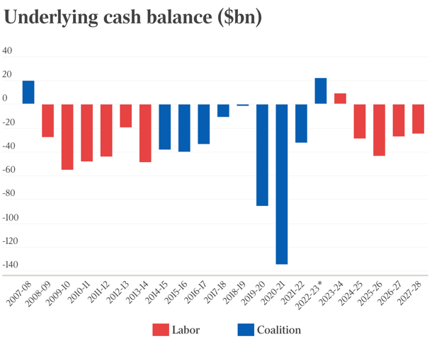
Student Presentations – Topic E Fiscal Policy
Examine the graph above and answer the following questions:
“The Treasurer announced that the forecast underlying cash balance position for the 2024/25 financial year was a deficit of $28.3billion (or 1.0% of GDP).”
Identify the current fiscal policy stance and explain why the planned budget outcome for 2024/25 may not be equal to the actual budget outcome for that year.
Describe two methods for financing a budget deficit.
Explain two impacts of government debt on the Australian economy.
Source: The Guardian (2023)

Slide 14
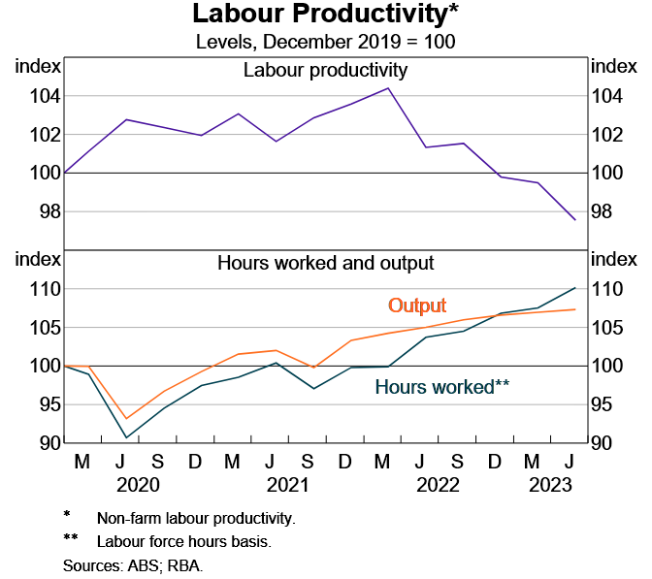
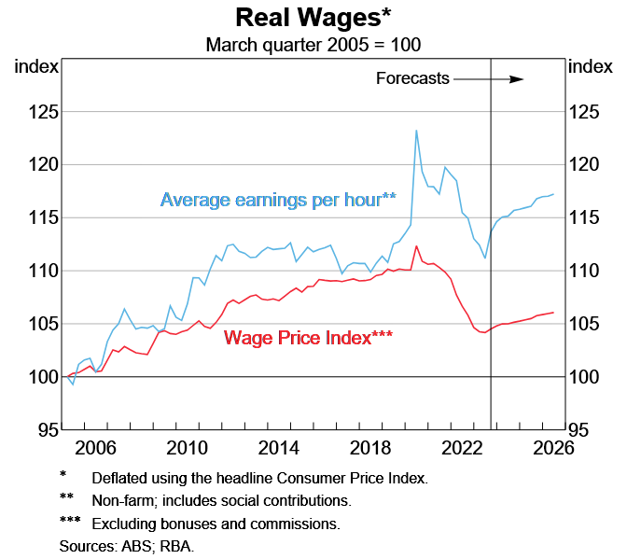
Student Presentations – Topic F Labour Productivity
Examine the graph and answer the following questions:
Define labour productivity and explain why it is important for long-run economic growth.
Outline two factors that could account for changes in Australia’s labour productivity since 2021.
Outline two government policies that could improve labour productivity.
Explain the effect of a substantial increase in wages growth without growth in productivity.
Source: Reserve Bank of Australia (2023)

Slide 15
Student Presentations – Topic G Aggregate Expenditure
Examine the graph above and answer the following questions:
Referring to the graph above, outline the key factors driving economic growth in Australia.
Explain why the Reserve Bank of Australia aims to achieve price stability in the economy.
The Australian Bureau of Statistics stated in February 2024 that the Australian savings ratio is at a 17-year low, just 1.1% of total disposable income. Explain how a decrease in savings ratio impacts the level of economic activity in Australia.
Source: Reserve Bank of Australia, (2024)
‘Chart Pack’

Slide 16
Behavioural terms - type of response
Text form | Behavioural term | Definition / detail
Factual or procedural | Define | State meaning and identify essential qualities
 | List | Provide a series of related words, names, numbers or items that are arranged in order, one after the other
 | Outline | Sketch in general terms; indicate the main features of
 | State | Express the main points of an idea or topic, perhaps in the manner of 'describe' (see above)
 | Describe | Provide key characteristics and features
 | Identify | Recognise and name
Cause and effect’ responses - Explanatory or analysis | Explain | Relate cause and effect; make the relationships between things evident; provide why and/or how
 | Account for | State reasons for, report on.
 | Analyse | Identify components and the relationship between them; draw out and relate implications
 | Discuss | Identify issues and provide points for and/or against
 | Differentiate / distinguish | Recognise or note/indicate as being distinct or different from; note differences between
 | Examine | Inquire into
Other | Demonstrate | Show by example
 | Summarise | Express, concisely, the relevant details
 | Determine | Decide, find out

Slide 17
Upcoming Events

Slide 18
Thank you

