Slide 1
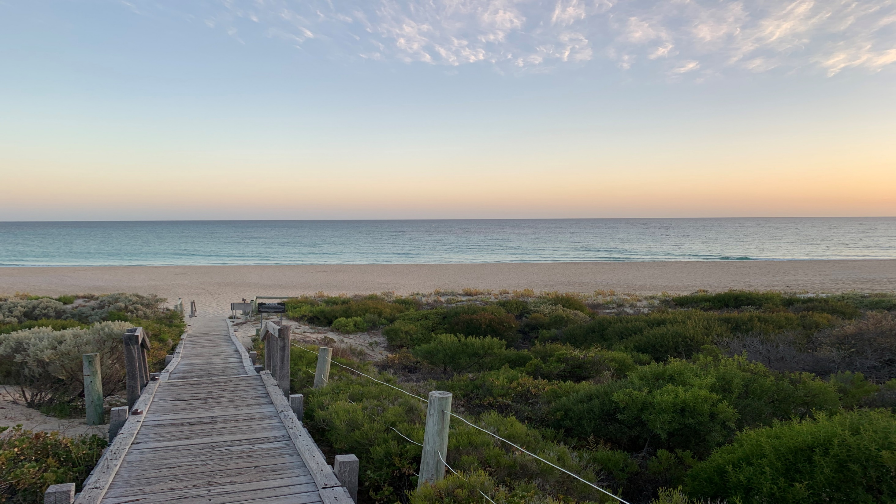
August 2023
The economic landscape
Sam Collins – CCIWA Senior Economist

Slide 2
Overview
The broader economic landscape
The local economy
What comes next

Slide 3
The broader economic landscape
Inflation and interest rates

Slide 4
Global inflation
Source: CCIWA, Refinitiv

Slide 5
Teetering on the edge

Slide 6
Recession risk
Source: CCIWA, St. Louis Federal Reserve
Source: CCIWA, Refinitiv

Slide 7
World growth rates
Source: CCIWA, IMF

Slide 8
The local economy

Slide 9
Diamond in the rough
Source: CCIWA, ABS

Slide 10
Breaking down WA’s economy
Source: CCIWA, ABS

Slide 11
Flowing through the economy

Slide 12
Iron ore: China needs us
Source: Goldman Sachs

Slide 13
Consumption remains steady

Slide 14
But households are looking to cut back

Slide 15
Businesses aren’t without challenges…

Slide 16
Costs and labour remain front of mind

Slide 17
Interest repayments reducing margins

Slide 18
Labour market still tight but starting to ease
Source: CCIWA, ABS

Slide 19
Job vacancies falling

Slide 20
Businesses still struggling to hire, but it’s slightly better

Slide 21
How businesses are responding

Slide 22
Wage pressure tightening, eating away at margins

Slide 23
What comes next

Slide 24
Everything in its proper context…
Source: CCIWA, St. Louis Federal Reserve

Slide 25
Everything in its proper context…
Source: CCIWA, St. Louis Federal Reserve

Slide 26
World growth rates
Source: CCIWA, IMF

Slide 27
US inflation
Source: CCIWA, Refinitiv

Slide 28
Australian rates – where do they go?
Source: CCIWA, ABS

Slide 29
What about WA?

Slide 30
Iron ore outlook steady

Slide 31
Business insolvencies
Source: CCIWA, ASIC

Slide 32
Industry breakdown
Source: CCIWA, ASIC

Slide 33
Households well placed
Source: CCIWA, ABS
Source: CCIWA, APRA

Slide 34
Mortgage defaults still low
Source: CCIWA, Supreme Court of Western Australia

Slide 35
Housing sector
Source: CCIWA, ABS

Slide 36
Population picture
Source: CCIWA, ABS

Slide 37
Population

Slide 38
Population Growth
Source: Commonwealth Government Budget Papers [2023]

Slide 39
August 2023
The economic landscape
Sam Collins – CCIWA Senior Economist

